Slide 1
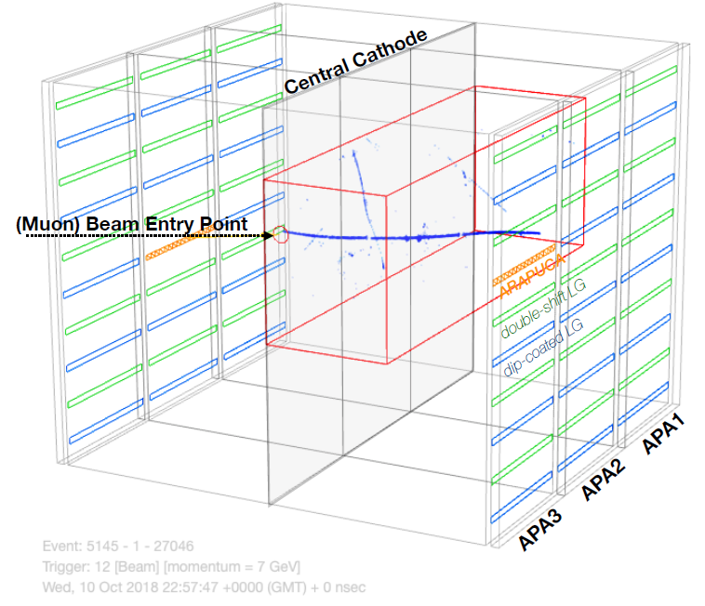
Detector Performance
TPC
Noise Level and Charge Extraction
Calorimetry: dE/dx
Particle Identification
PDS
Light Yield
Calorimetric Energy from Light

Slide 2
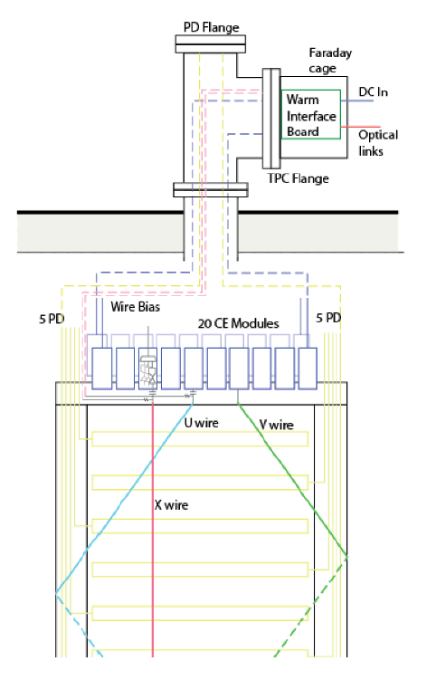
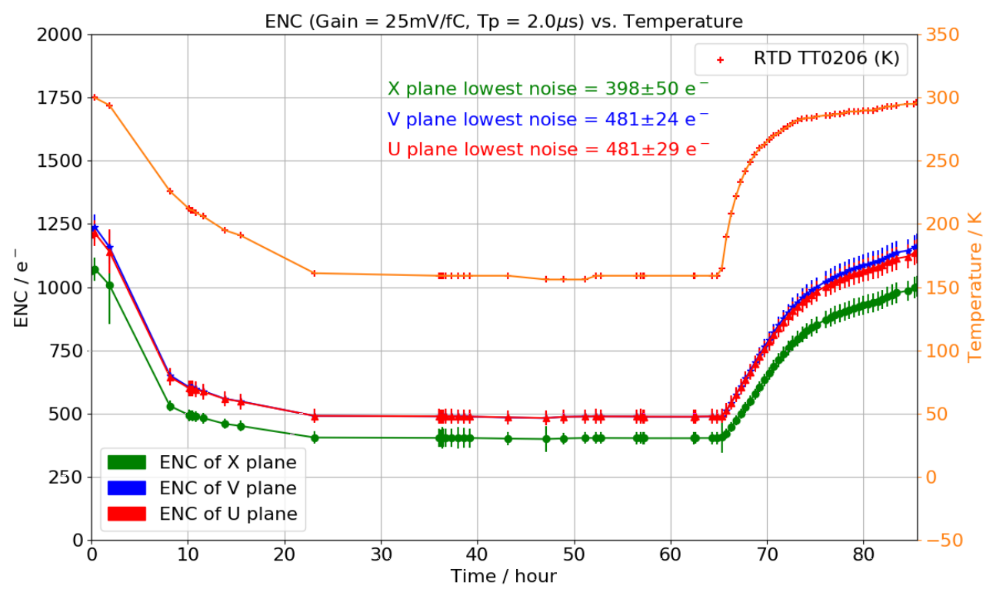
Cold Electronics Performance
JINST 15 (2020) 06, P06017
Cold electronics installed on APA
Notes:
Move to later

Slide 3
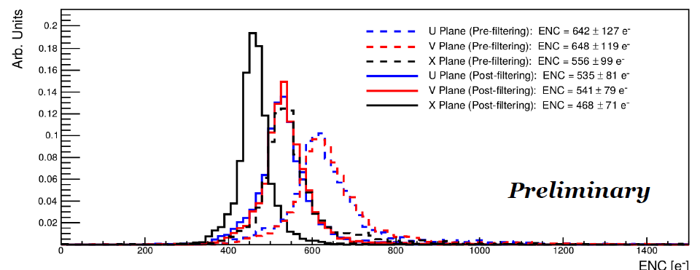
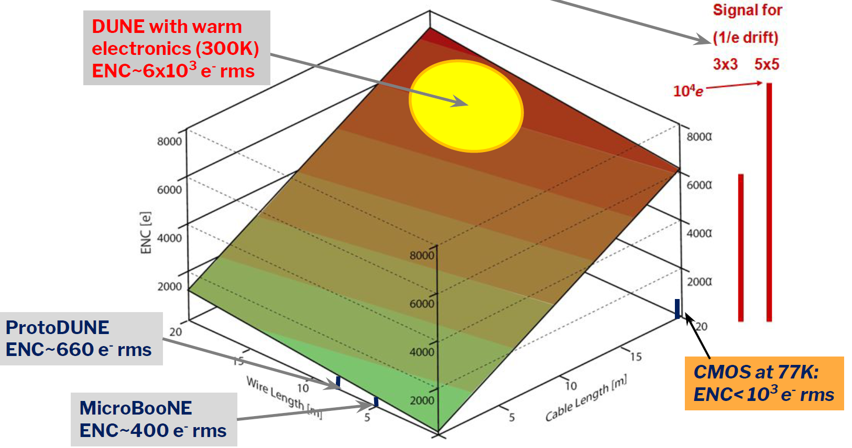
Noise Level
The noise level well agrees the expectation from the cold electronics design
Software filter further reduce the noise
Notes:
Low noise level even before the software filter, hardware is good

Slide 4
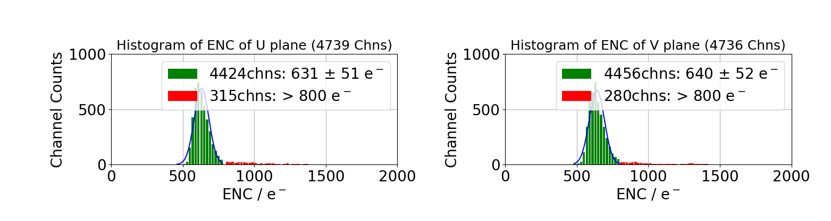
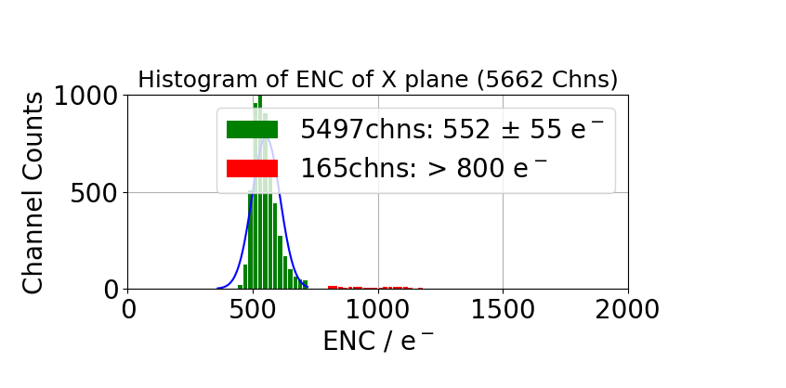
TPC Channels and Electronics Noise
Total TPC channels: 15360
99.74% (15320 of 15360) TPC channels are active
92.83% (14259 of 15360) TPC channels are working with excellent noise performance (ENC < 800e-)

Slide 5
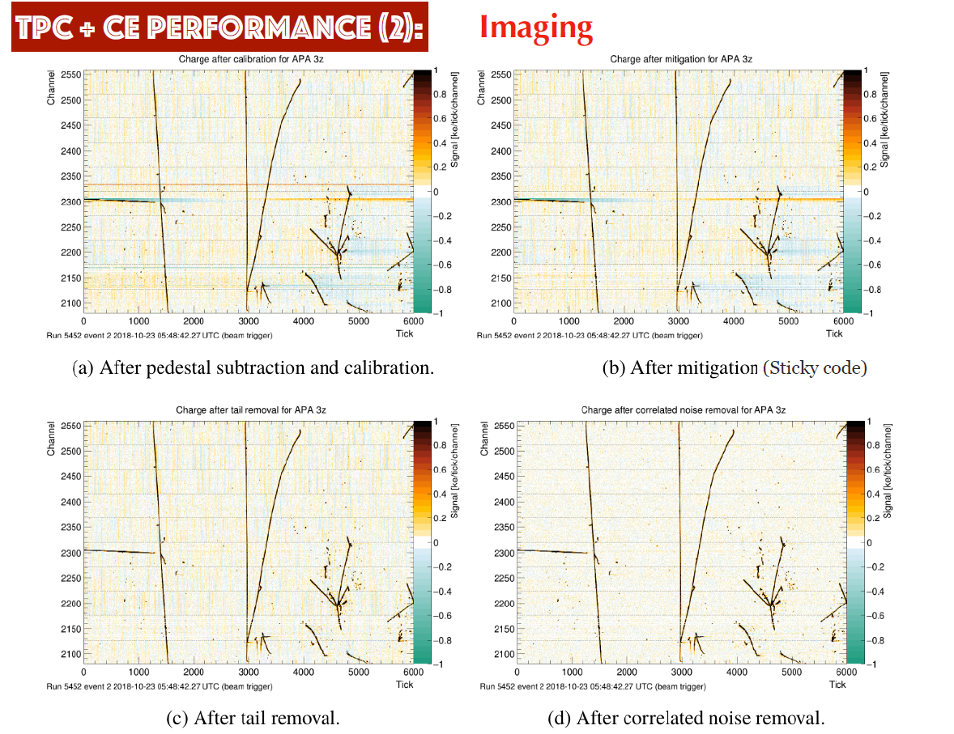
2-D Images from One Wire Plane
Wire
Time
Notes:
What’s X and Y axis? Explain and label

Slide 6
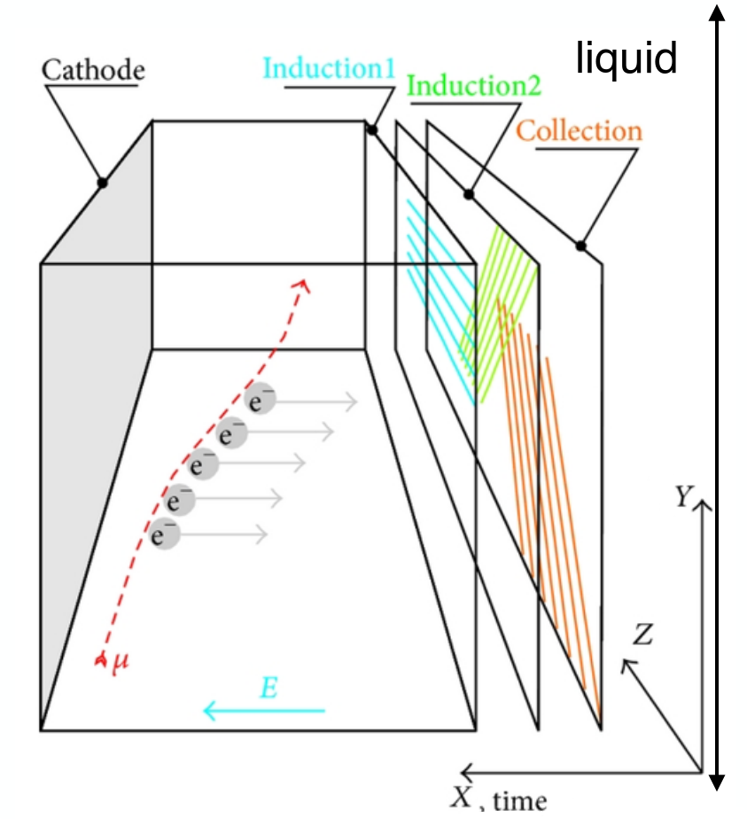
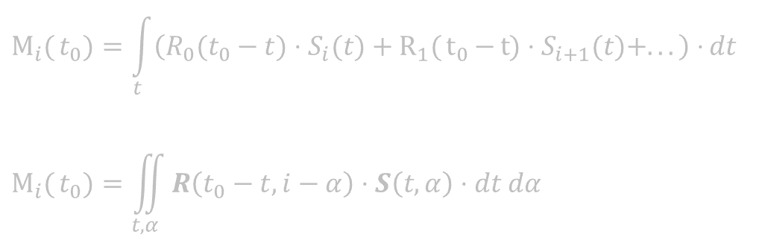

2-D Deconvolution Technique
JINST 13 P07006 (2018)
A novel signal processing technique developed at BNL for MicroBooNE
Consider the long-range induction effect in a 2D deconvolution kernel (time + wire)
$$M_{i}{(}t_{0})=\int_{t}{\left(R_{0}(t_{0}−t)⋅S_{i}(t)+R_{1}{(}t_{0}{−}t{)}⋅S_{i+1}(t)+...\right)⋅}dt$$
$$M_{i}{(}t_{0})=\iint_{t, α}{R\left(t_{0}−t, i−α\right)⋅S\left(t, α\right)⋅dt dα}$$
t: time, $α$: wire
Equivalently, recover ionization charges from induced current from all adjacent wires
Notes:
One of the areas that is closest to my heart is the TPC simulation and signal processing.

Slide 7
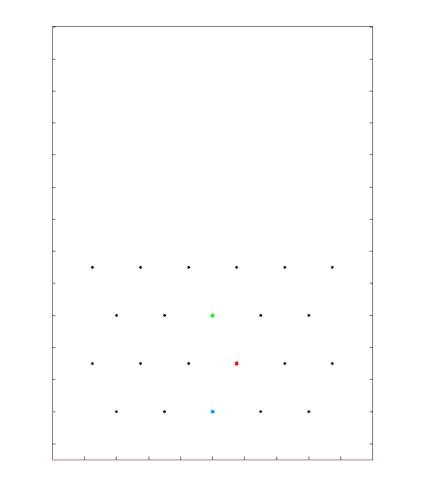
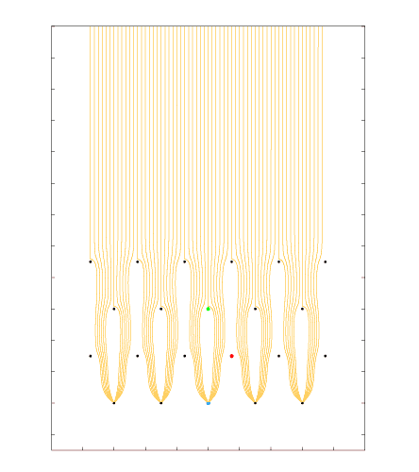
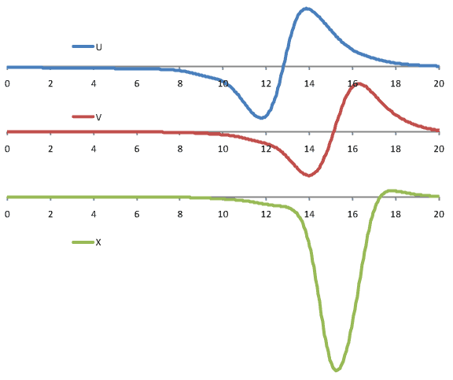
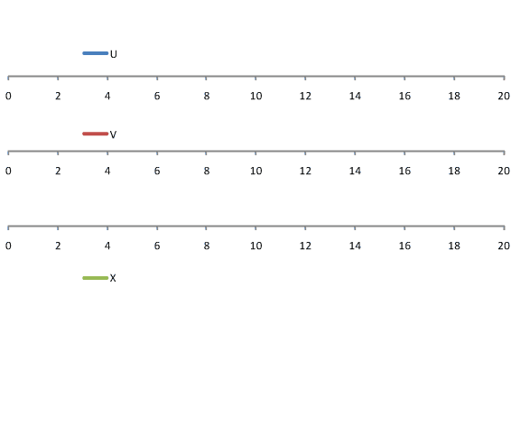
Revisit the Concept
Cartoon animation made by Bo Yu (BNL)
Ionization electrons drifted and induced current read out by three (1D) wire planes
Notes:
Emphasize the position and energy determination
Current shape is not a key point here

Slide 8
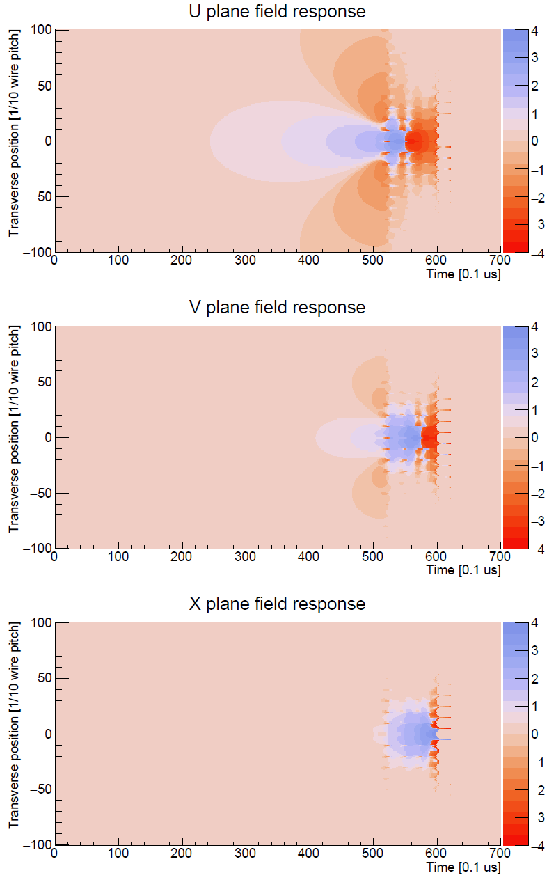


2-D Deconvolution Technique
JINST 13 P07006 (2018)
A novel signal processing technique developed at BNL for MicroBooNE
Consider the long-range induction effect in a 2D deconvolution kernel (time + wire)
$$M_{i}{(}t_{0})=\int_{t}{\left(R_{0}(t_{0}−t)⋅S_{i}(t)+R_{1}{(}t_{0}{−}t{)}⋅S_{i+1}(t)+...\right)⋅}dt$$
$$M_{i}{(}t_{0})=\iint_{t, α}{R\left(t_{0}−t, i−α\right)⋅S\left(t, α\right)⋅dt dα}$$
t: time, $α$: wire
Equivalently, recover ionization charges from induced current from all adjacent wires
Notes:
One of the areas that is closest to my heart is the TPC simulation and signal processing.

Slide 9
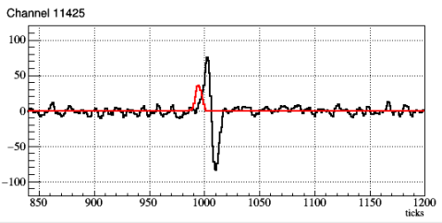
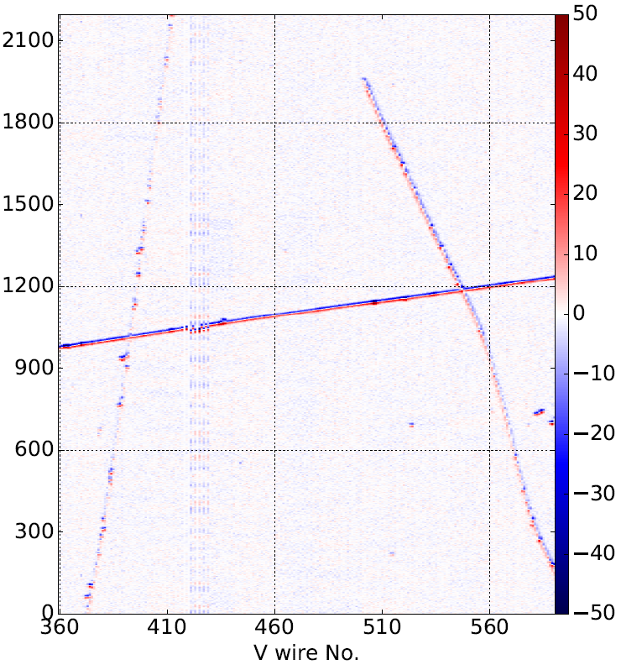
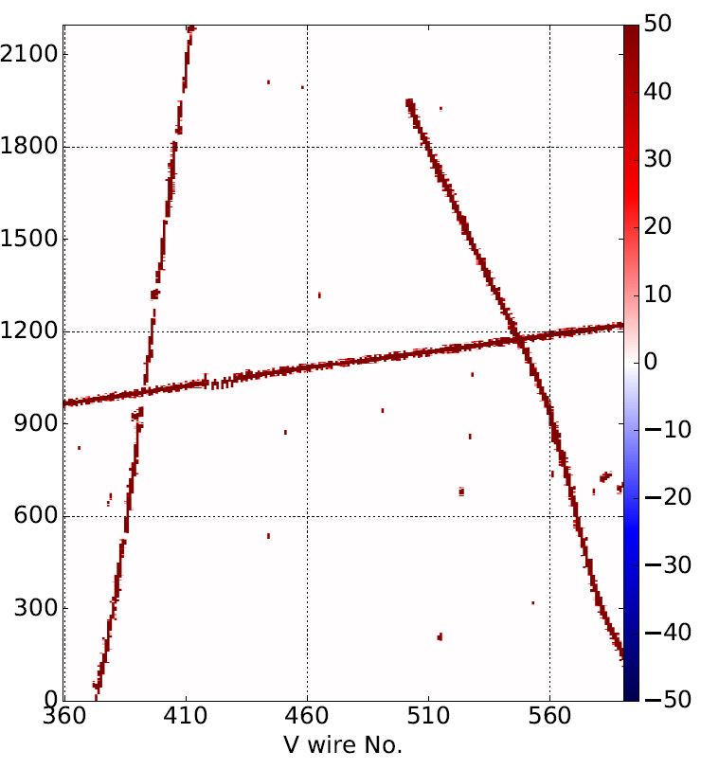
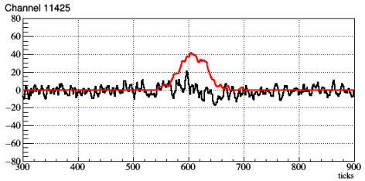
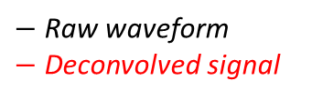
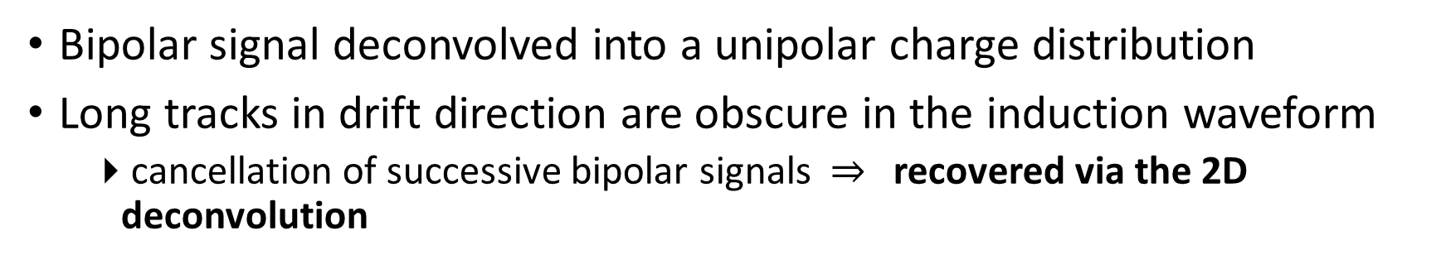
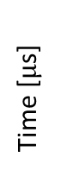
Signal Processing Example
wire 385
(Shallow angle track)
$−$ Raw waveform
$−$ Deconvolved signal
After Noise Filtering
After 2-D Deconvolution
wire 385
wire 385
Time [$μ$s]
wire 385
(Large angle track)
Topology dependence
Bipolar signal deconvolved into a unipolar charge distribution
Long tracks in drift direction are obscure in the induction waveform
cancellation of successive bipolar signals $⇒$ recovered via the 2D deconvolution

Slide 10
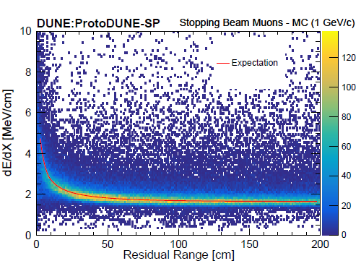
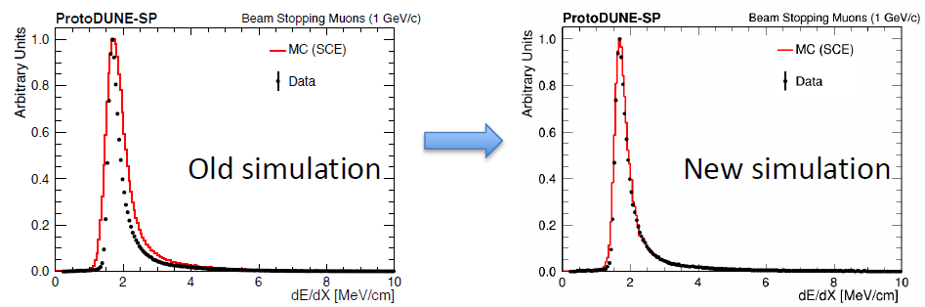
TPC Performance: dEdx - Calorimetry
Use stopping muon to determine the absolute dE/dx energy scale
A good understanding of the long-range induction effect improves the data-MC agreement

Slide 11
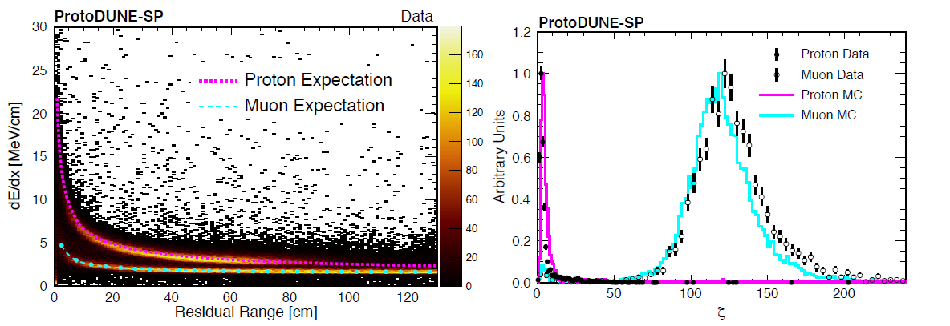
TPC Performance: Particle ID
Well understood detector response to particles of different types
Excellent separation of muons and protons using calorimetric information

Slide 12
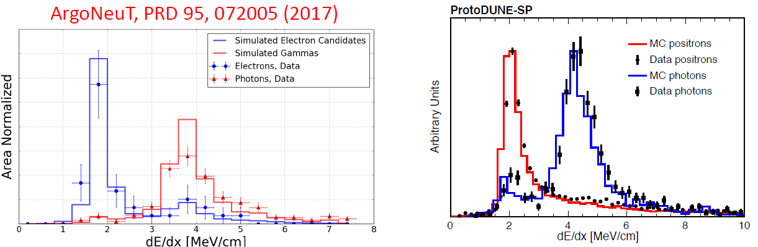
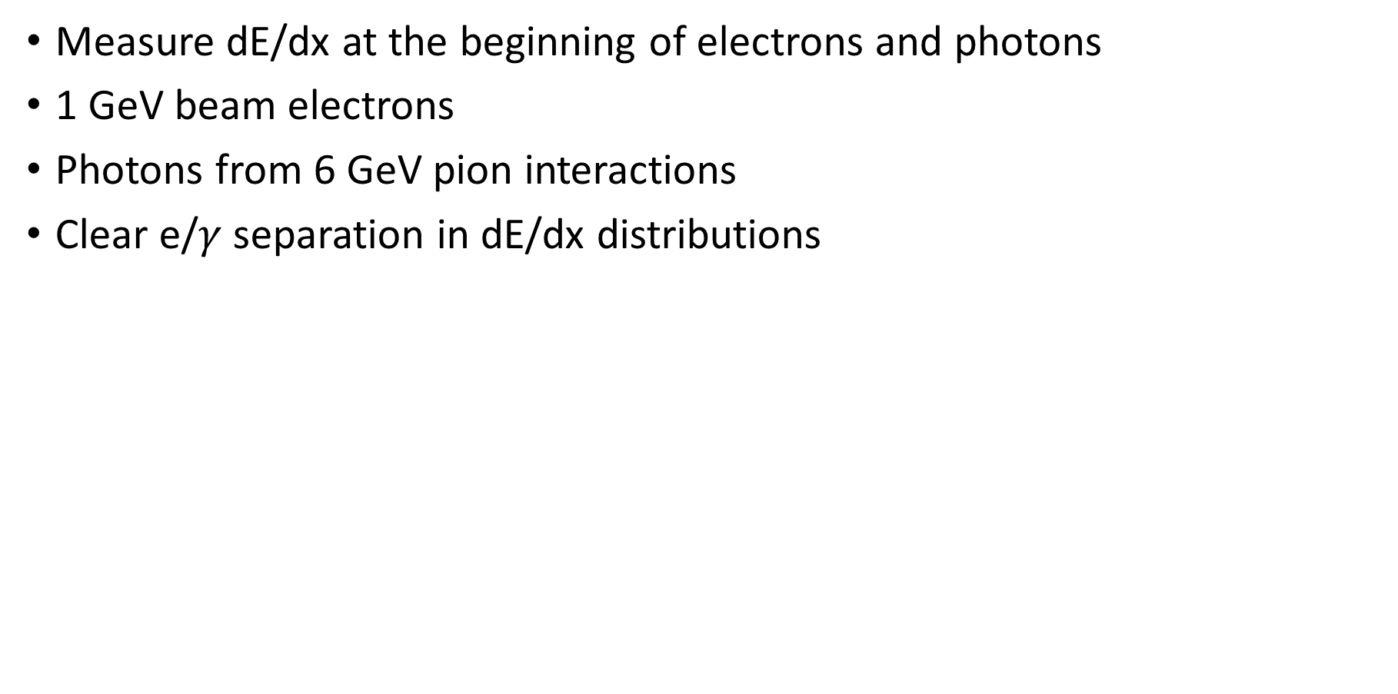
TPC Performance: Electron/photon dE/dx
Measure dE/dx at the beginning of electrons and photons
1 GeV beam electrons
Photons from 6 GeV pion interactions
Clear e/$γ$ separation in dE/dx distributions
Notes:
Fully automated reconstruction and large statistical event selection

Slide 13
Detector Performance
TPC
Noise Level and Charge Extraction
Calorimetry: dE/dx
Particle Identification
PDS
Light Yield
Calorimetric Energy from Light

Slide 14
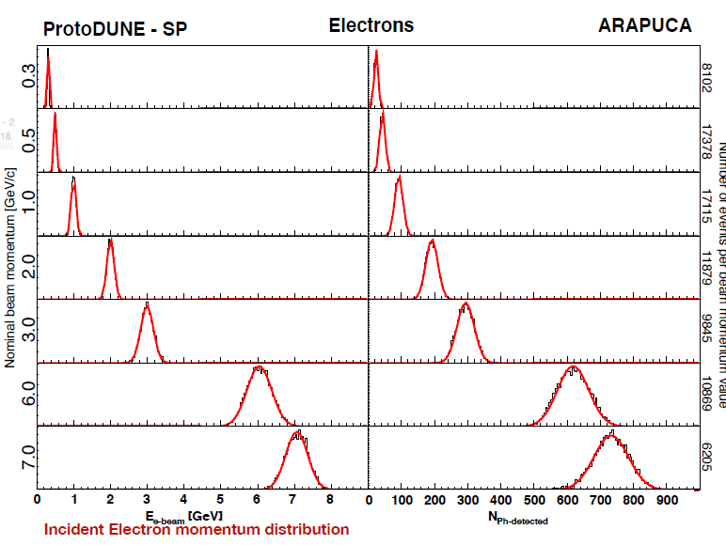
Photon Detector Performance

Slide 15
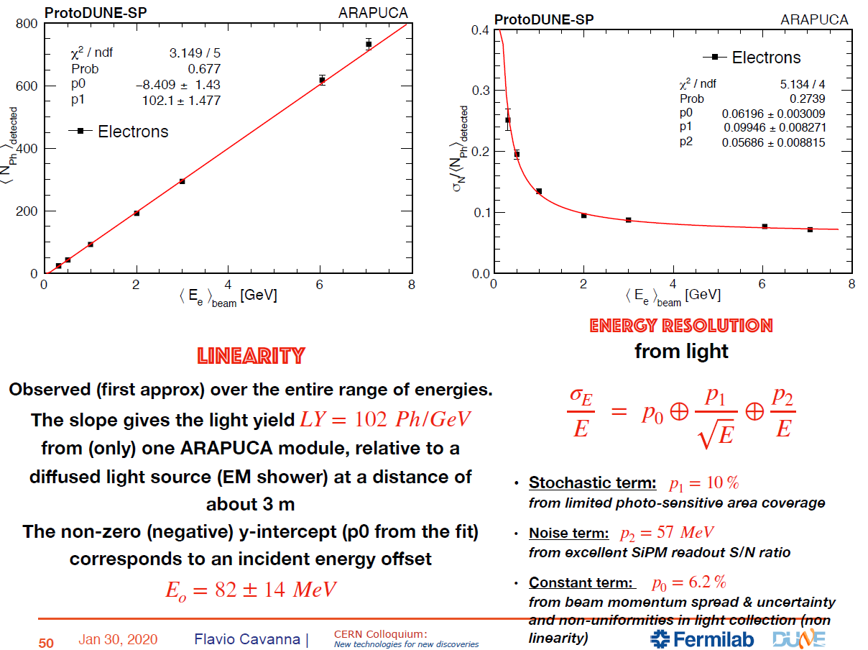
Photon Detector Performance
LY = 102 ph/GeV
Light Yield
Energy Resolution from Light

Slide 16
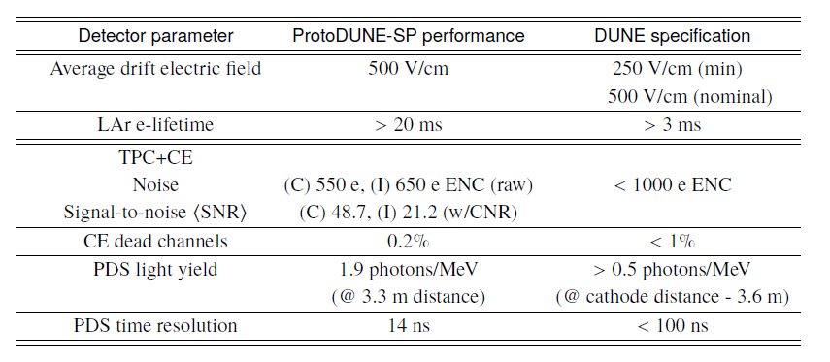
Summary of the Performance
The performance meets or exceeds the DUNE specification
Successfully demonstrates the effectiveness of the single-phase design
Notes:
Add one more slide on lifetime!

Slide 17
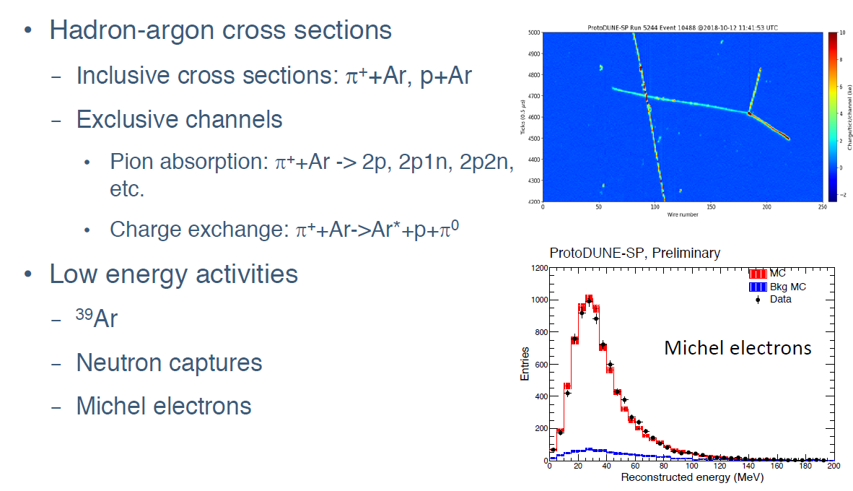
Other Ongoing Development
Notes:
Here I list some of the interesting topics
Also some pineer technique development
Pion exchange is also one of the background for DUNE signal

Slide 18
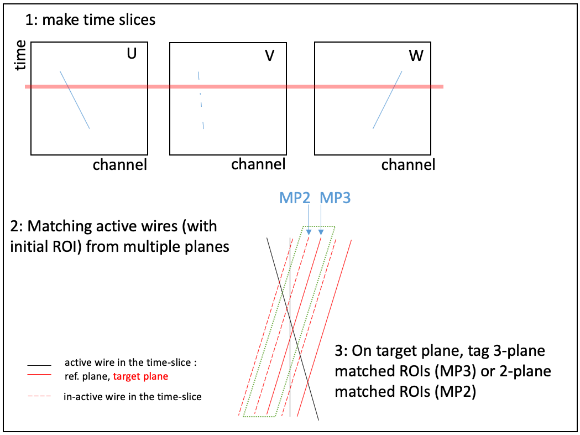
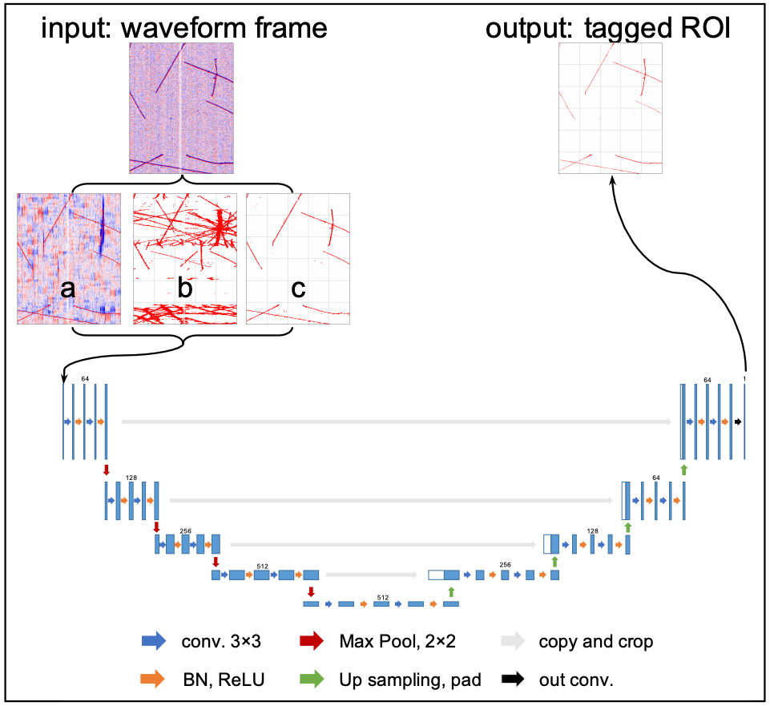
Deep Neural Network (DNN) for ROI Finding
Obtain multi-plane (MP) information
Network structure
Haiwang Yu et al. , arxiv: 2007.12743 (submitted to JINST)
Notes:
For the ROI finding alg:
We treat this as 2D semantic segmentation.
And used the UNet which showed good performance in segmentation in other domains.
However, we do not want to feed the raw ...

Slide 19
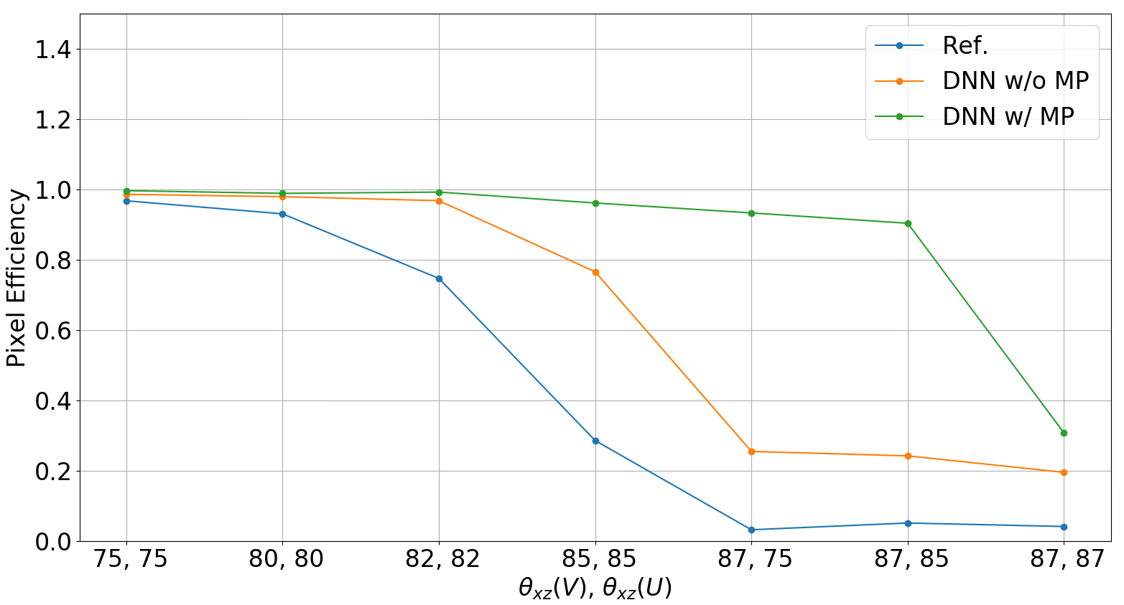
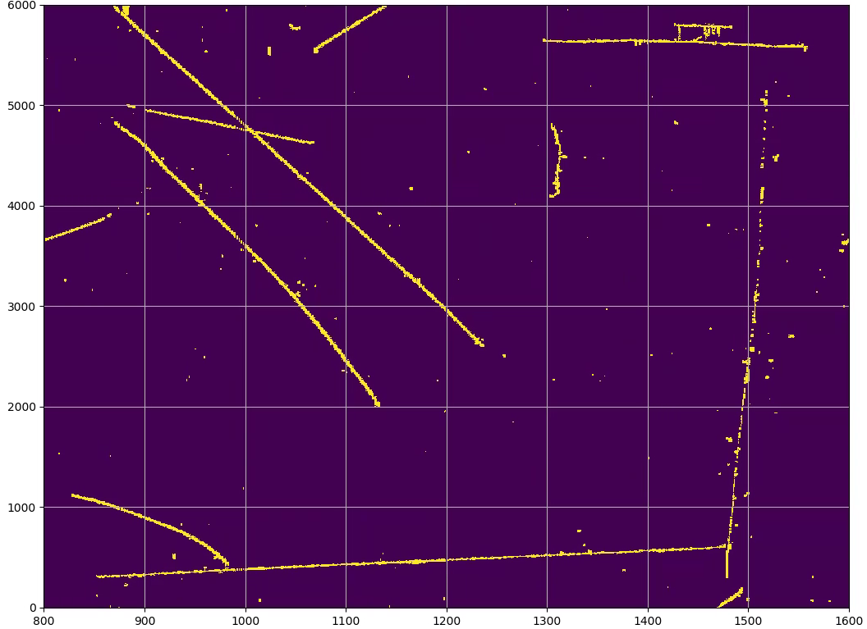
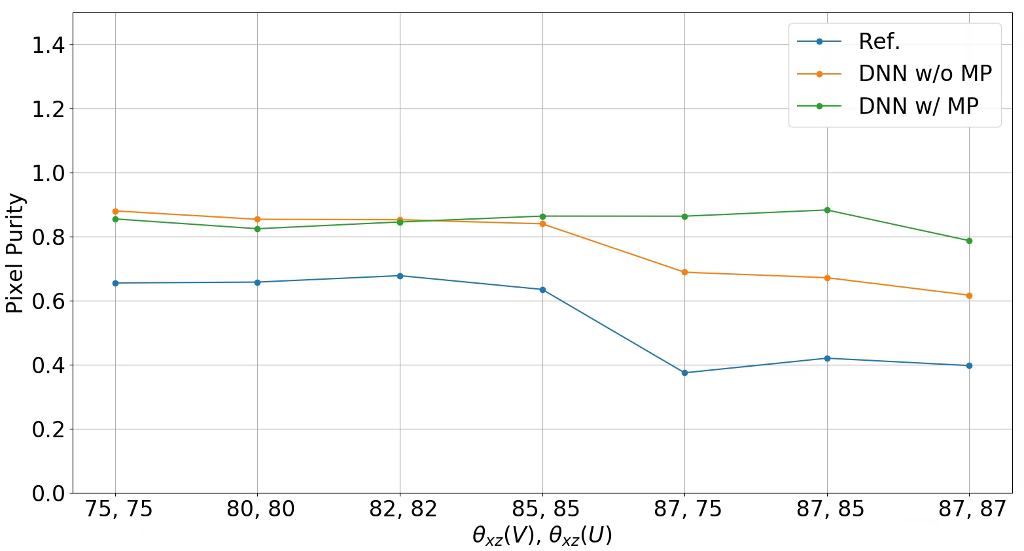
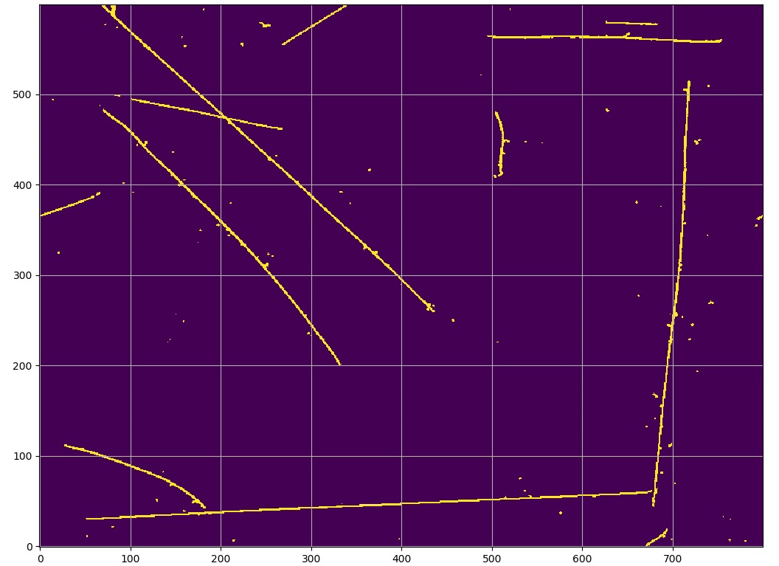
Boosting Performance for the ROI Finding
Evaluation on ProtoDUNE data
Evaluation on simulated line charges
Reference
DNN w/ MP
Notes:
The trained model was first evaluated with simulations of tracks at large angles:

Slide 20
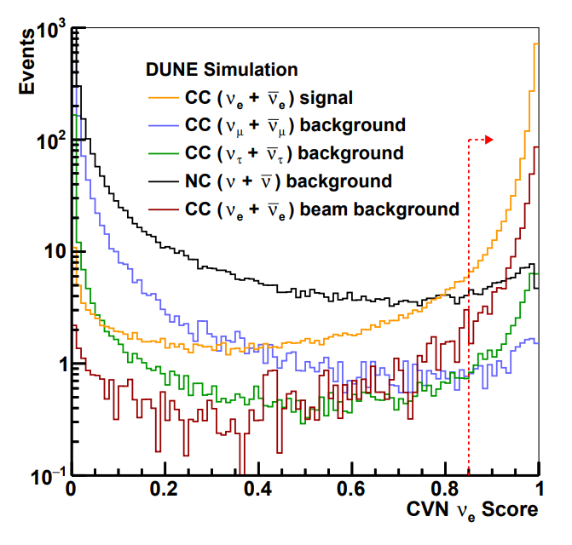
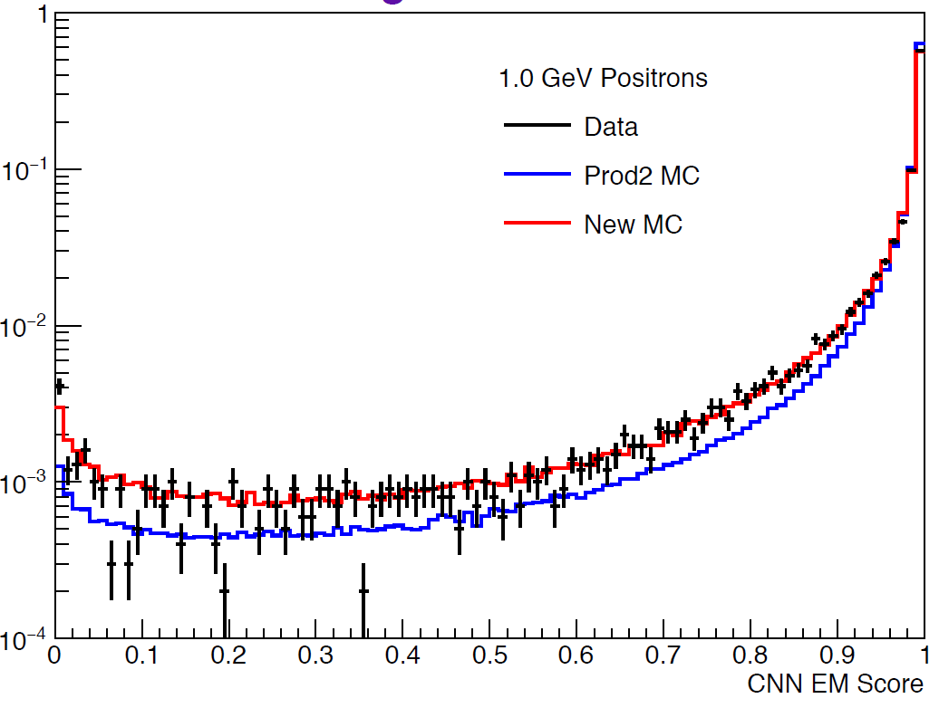
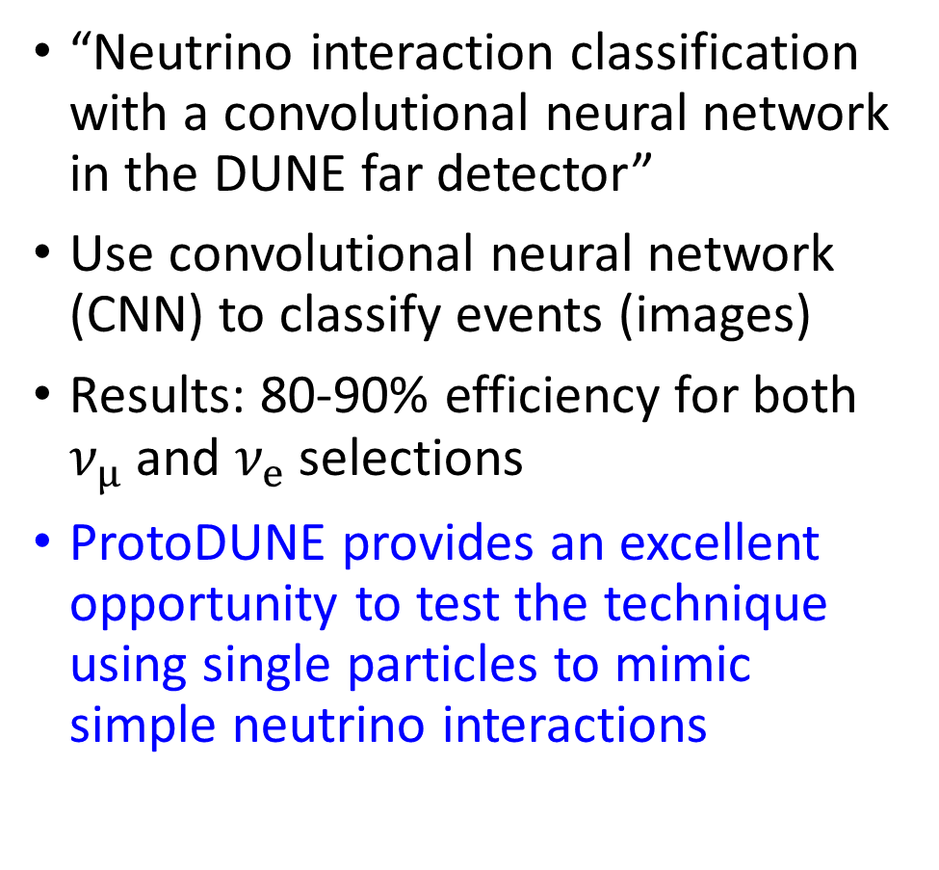
Event Reconstruction and Classification
arXiv:2006.15052
“Neutrino interaction classification with a convolutional neural network in the DUNE far detector”
Use convolutional neural network (CNN) to classify events (images)
Results: 80-90% efficiency for both $ν_{μ}$ and $ν_{e}$ selections
ProtoDUNE provides an excellent opportunity to test the technique using single particles to mimic simple neutrino interactions
ProtoDUNE-SP Preliminary
Notes:
Emphasize the contribution of the new simulation

Slide 21
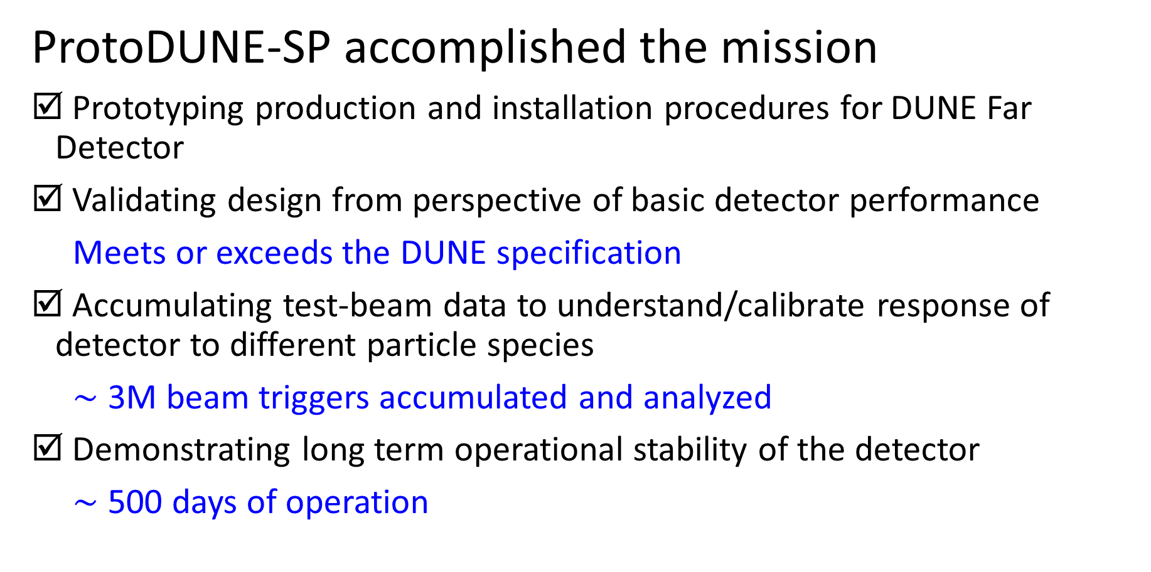
Final Remarks
ProtoDUNE-SP accomplished the mission
Prototyping production and installation procedures for DUNE Far Detector
Validating design from perspective of basic detector performance
Meets or exceeds the DUNE specification
Accumulating test-beam data to understand/calibrate response of detector to different particle species
$\sim$ 3M beam triggers accumulated and analyzed
Demonstrating long term operational stability of the detector
$\sim$ 500 days of operation
Notes:
Can cover more topics

Slide 22


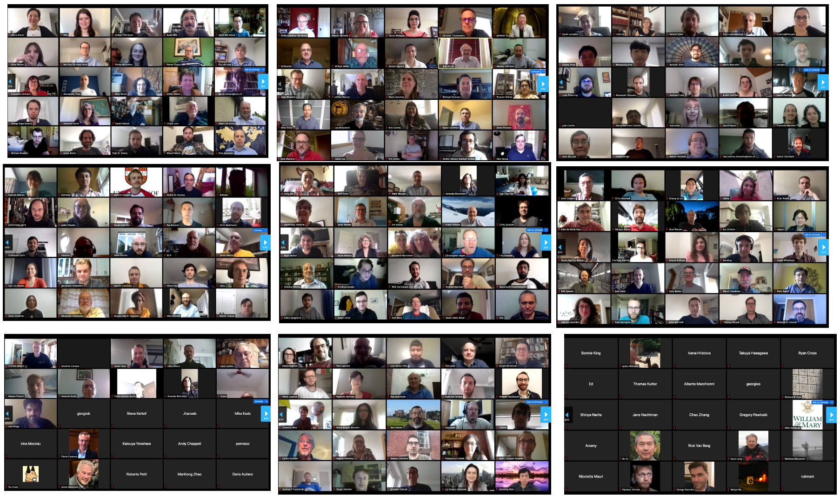
Thanks!
May 2020 Collaboration Photo

Slide 23
Backup Slides

Slide 24
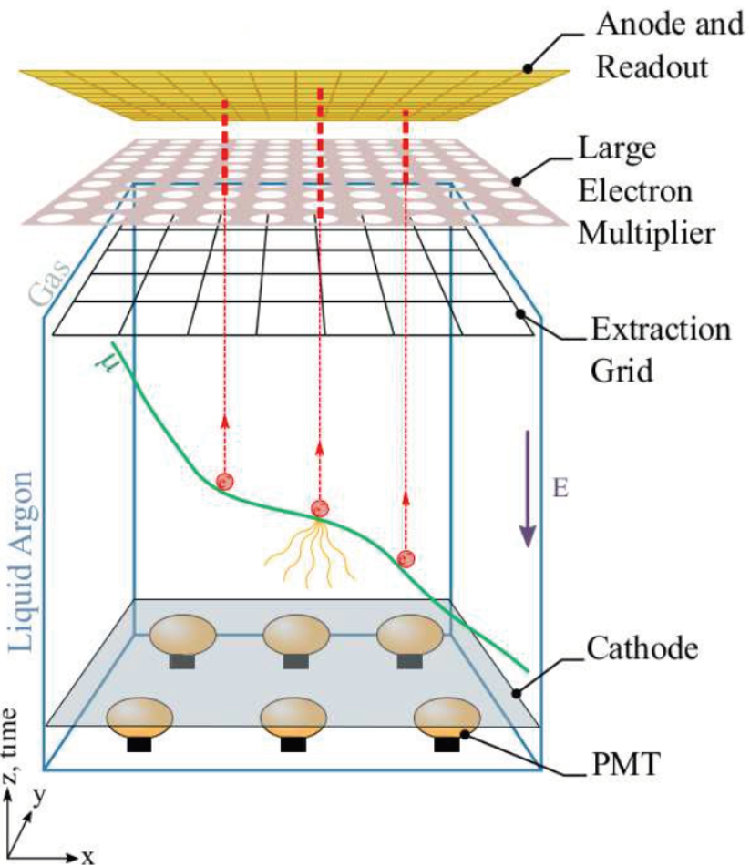
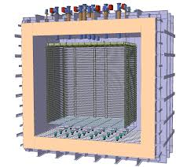
Dual-Phase ProtoDUNE
Electron signal amplified by Large Electron Multiplier (LEM) in gaseous argon
Charge collected on 2-D segmented anode
Vertical drift distance: 6 m

Slide 25
November 13, 2018: the beam is off!
Beam Run Summary

Slide 26
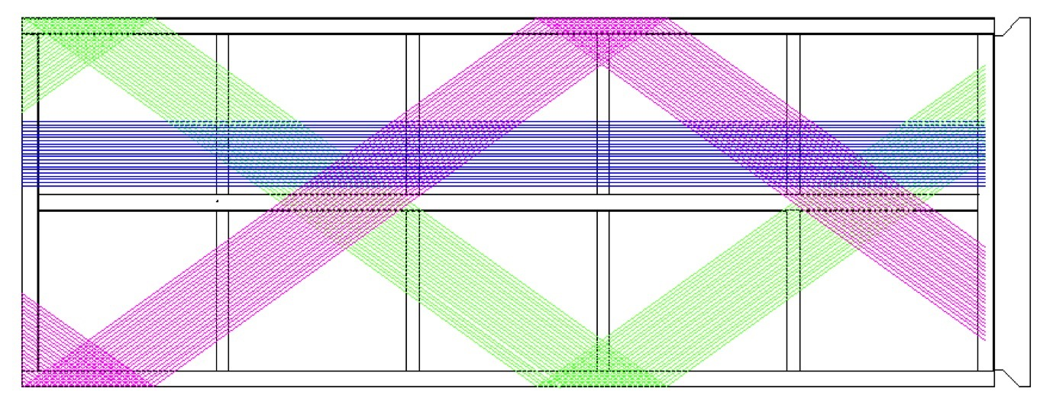
Wrapped Wire Readout Design
Photon Detectors
Stainless Steel frame
One APA
Collection (X)
2.295 m
Electronics Plate
Induction (V)
Induction (U)
5.920 m
Modular design for transportation and underground installation
Three (1D) wire planes with ~ 2560 readout channels. In comparison, would require half million channels for a 2D pixel readout with similar resolution (~ 5 mm pitch)
Considerations of cost and power consumption of electronics inside LAr

Slide 27
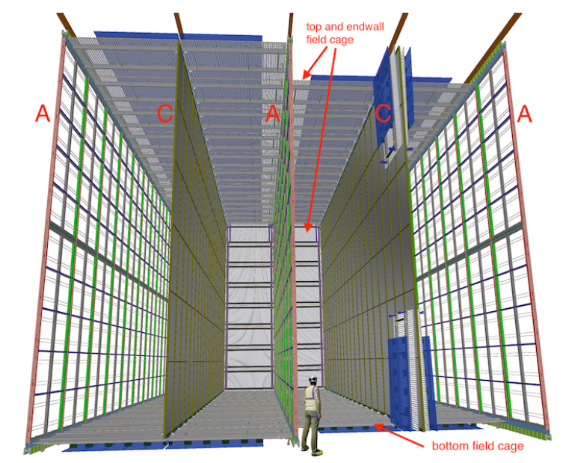
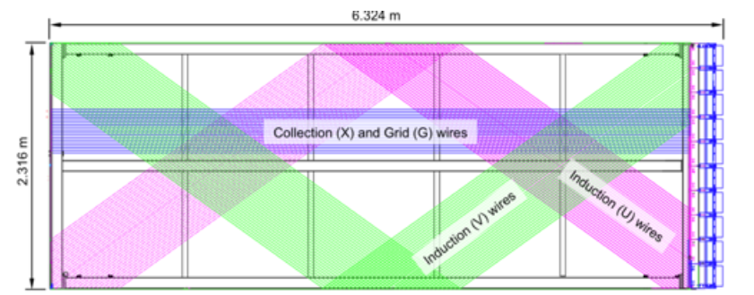
First Far Detector Module
Four 17-kton modules deployed in stages
First module will be single phase LArTPC
Single phase design uses modular drift cells (scalable)
Suspended Anode and Cathode Plane Assemblies (APAs and CPAs)
Wrapped wires: reduce number of readout channels, cabling complexity
3.6 m drift, 500 V/cm E-field; photon detectors for non-beam triggering

Slide 28
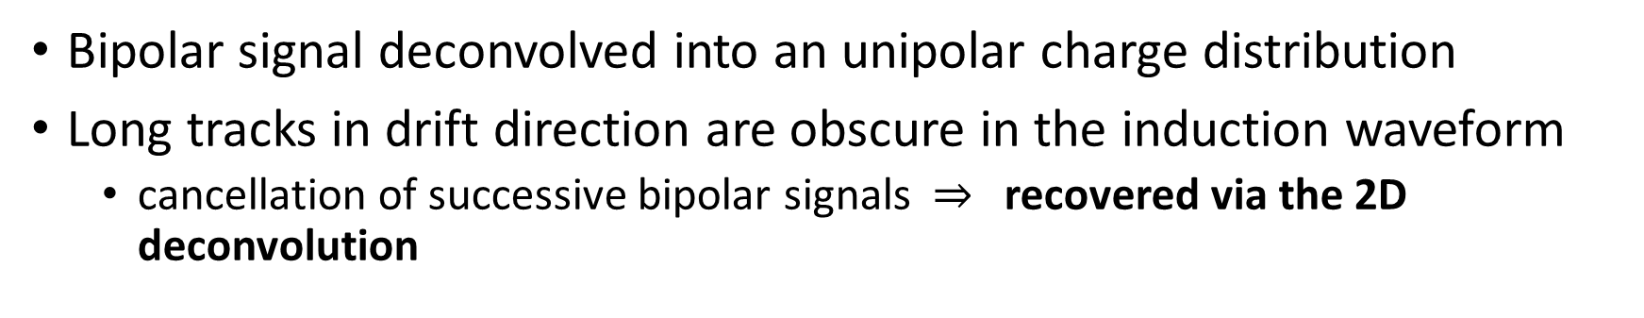
Signal Processing Example
wire 385
$−$ Raw waveform
$−$ Deconvolved signal
After Noise Filtering
After 2-D Deconvolution
wire 385
wire 385
Time [$μ$s]
wire 385
Topology dependence
Bipolar signal deconvolved into an unipolar charge distribution
Long tracks in drift direction are obscure in the induction waveform
cancellation of successive bipolar signals $⇒$ recovered via the 2D deconvolution

Slide 29
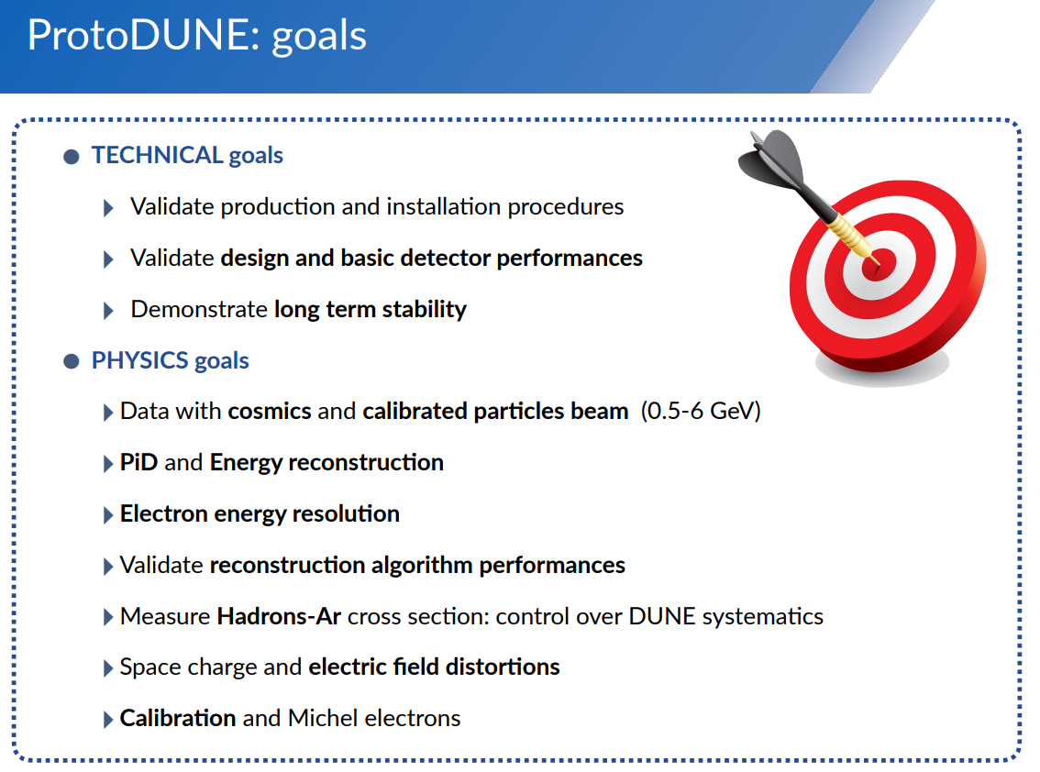

Slide 30
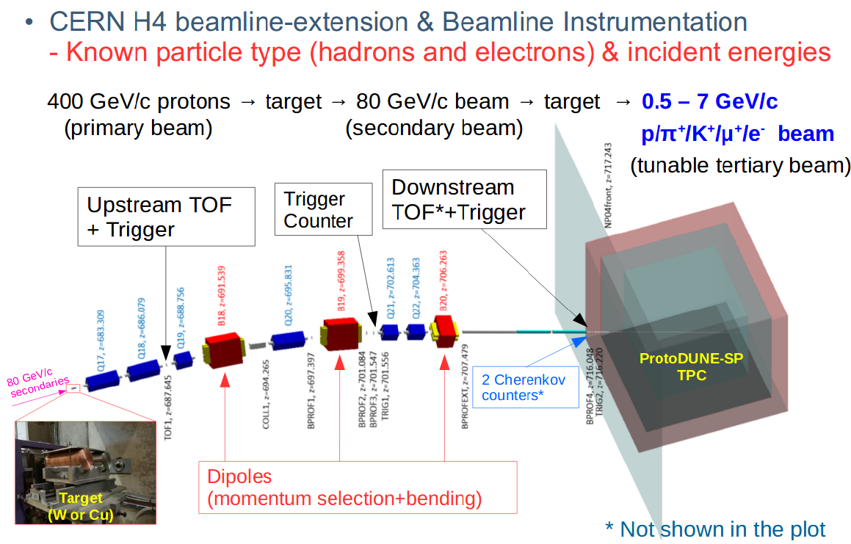

Slide 31


